Slide 1


EASY Move-in

Slide 2

Problem Statement
Construction of new buildings and structures always leads to a huge amount of problems for the people displaced.
Finding a new place as per person’s convenience and the similar environment is a tedious task to do it single-handedly.
It also leads to a wide array of new problems such as finding new schools, workplaces and safe areas to stay.

Slide 3

Solution
The aim of our application is to ease the search of the customer by communicating with the government and providing them the comfortable accommodations.
It takes care of the entire process starting from government approval as well as ending with the various amenities provided including getting them moved to the respective location.

Slide 4
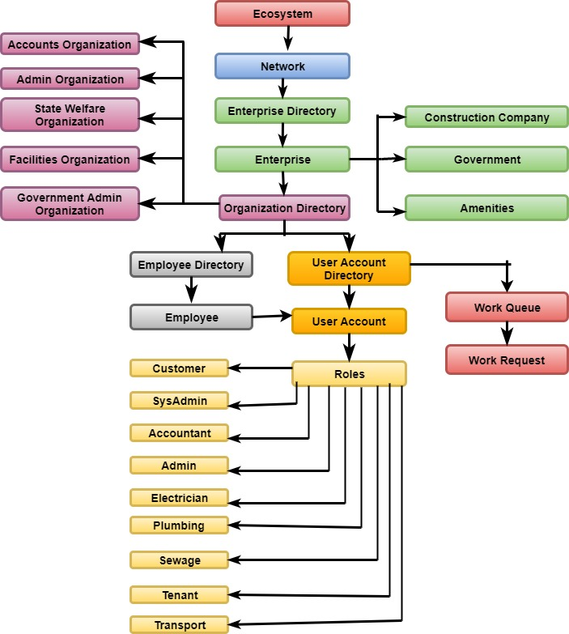
Object Model

Slide 5
Important Features
Event Handling using “Polling” of customers for their opinion.
Government approves request based on the polling results.
After customer selects an aprtment, requests are automatically send to the facilities to go ahead with moving and basic amenities.
Facilities send the requests to Electrician, Plumber, Sewage.
Once request is completed by all three only then the request is sent to Transport.
Facilities receive “Notification” to send the request to Transport.
Customer can track the progress in their smartphones using “QR Code Reader” generated for each customer.
Once the transport request is completed the customer’s “feedback” is enabled for overall work.
The graph is generated for the “Polling” as well as “Feedback”.

Slide 6
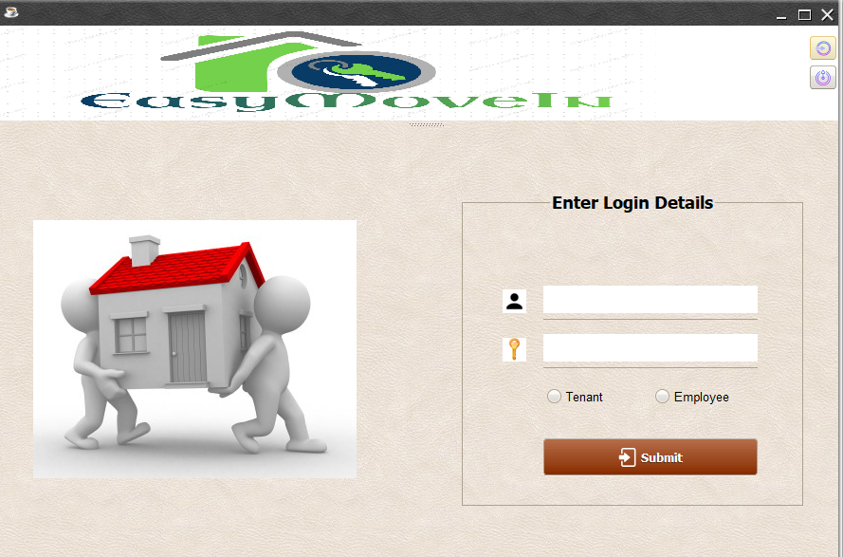
Login

Slide 7
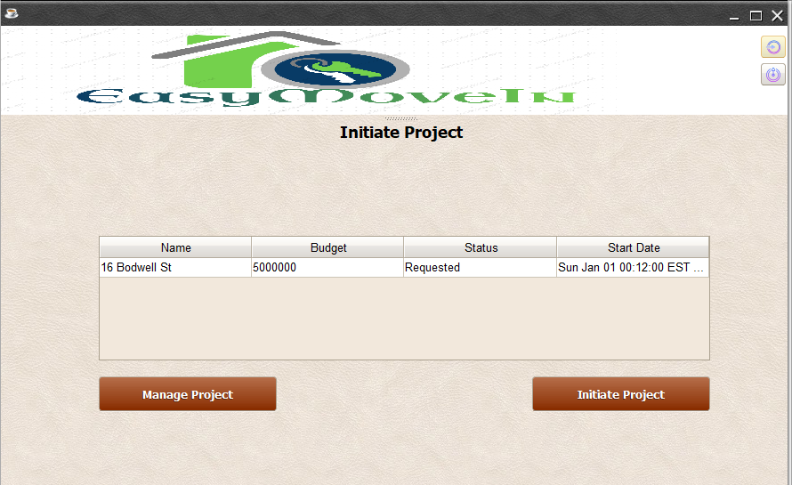
Project Initiation

Slide 8
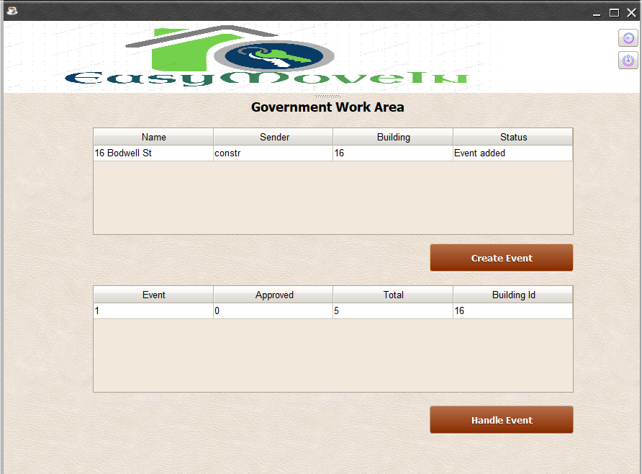
Event Creation

Slide 9
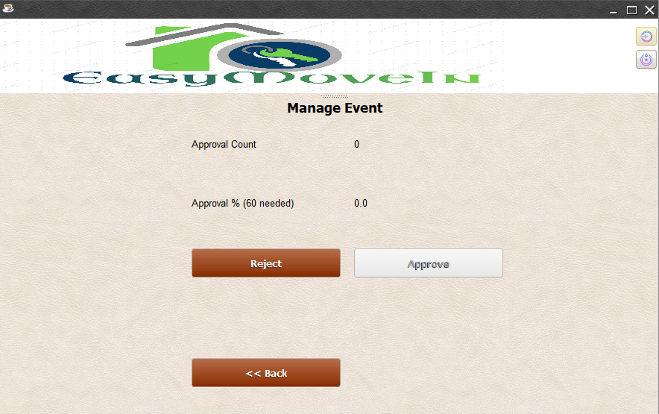
Handle Event

Slide 10
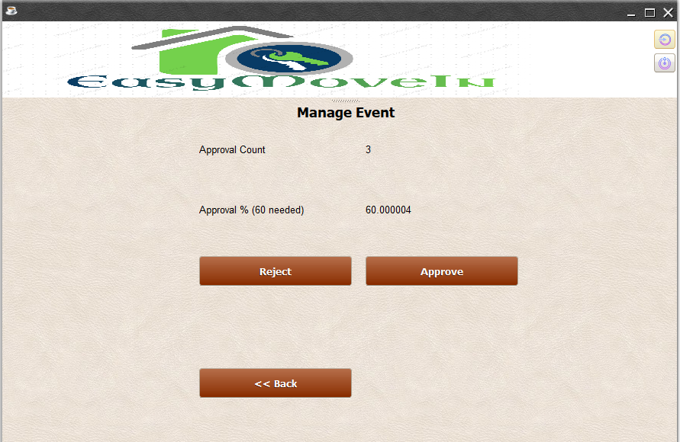
Approval Request

Slide 11
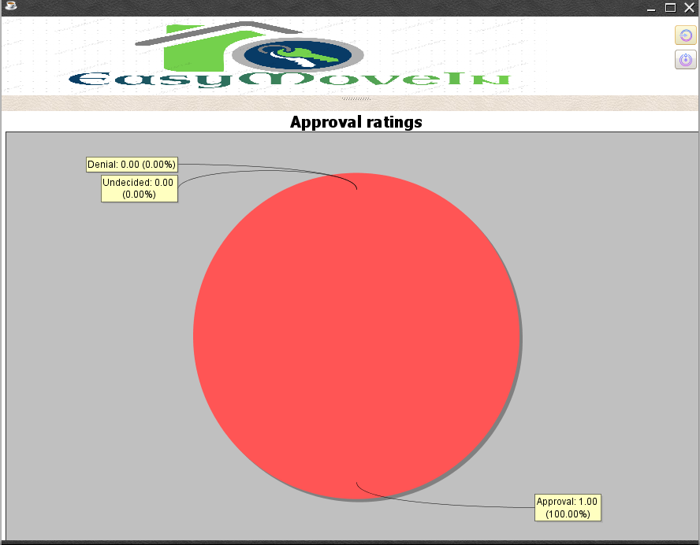
Poll Graph

Slide 12
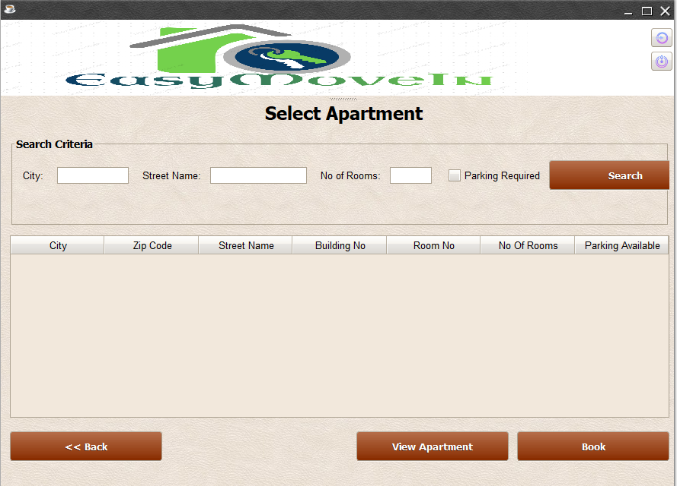
Select Apartment

Slide 13
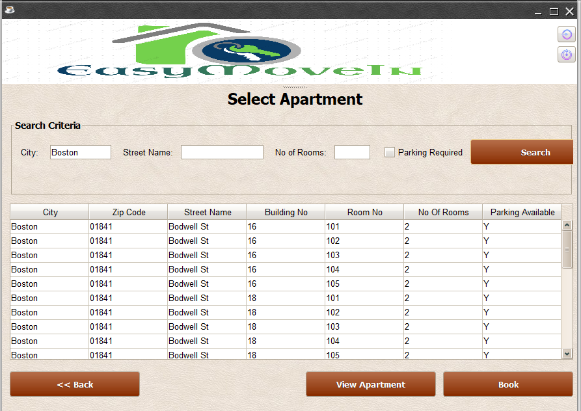

Slide 14
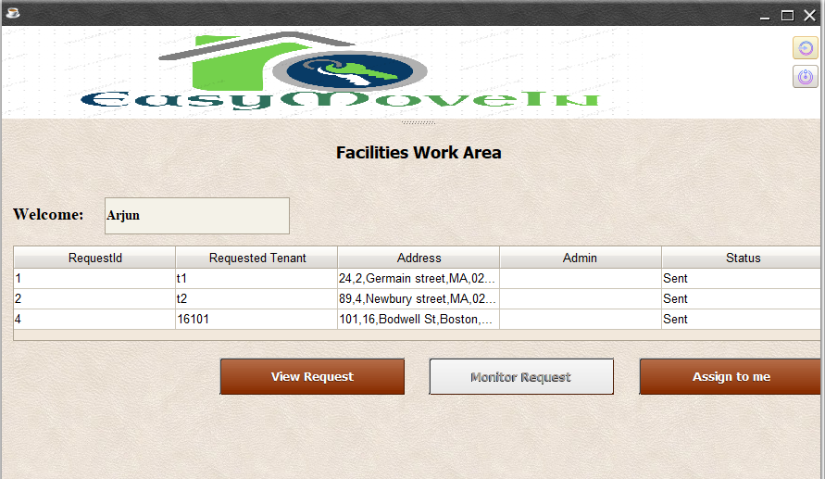
Facility Admin

Slide 15
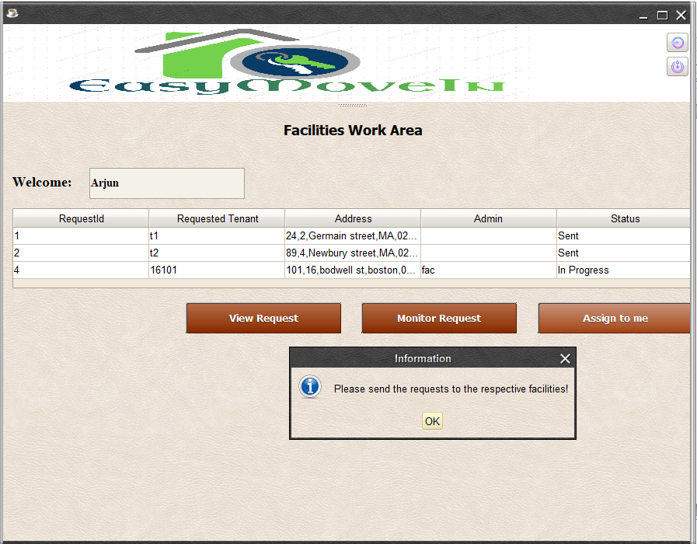
Facilities Monitor

Slide 16
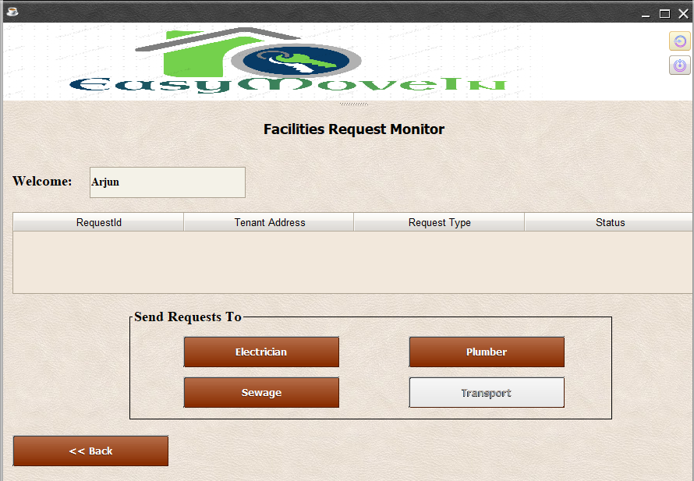
Monitor Request

Slide 17
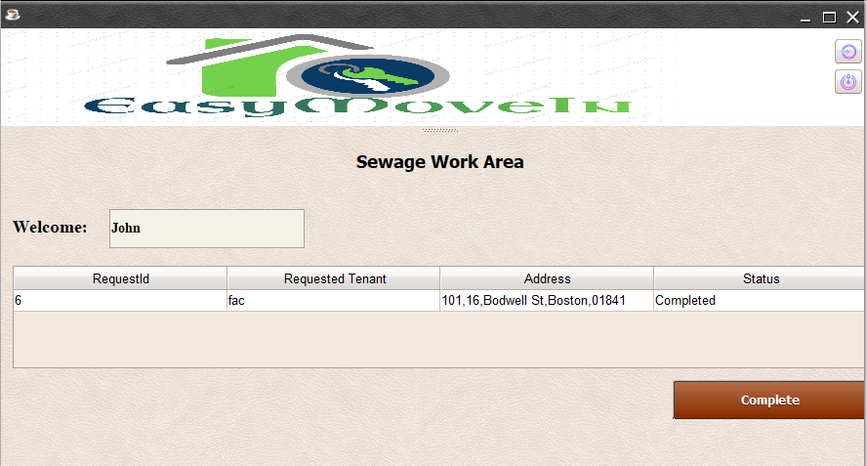
Sewage Request

Slide 18
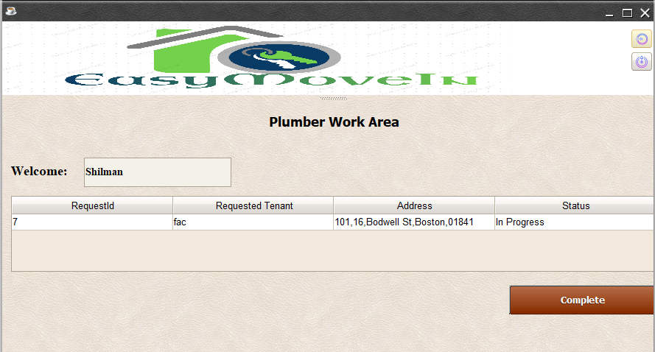
Plumber Request Handle

Slide 19
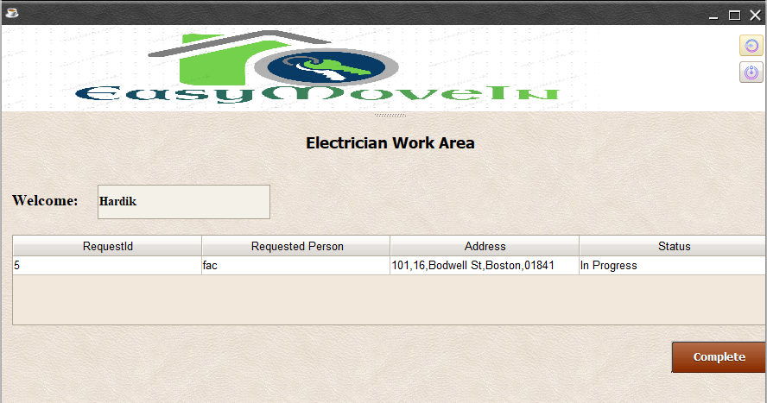
Electrician Request

Slide 20
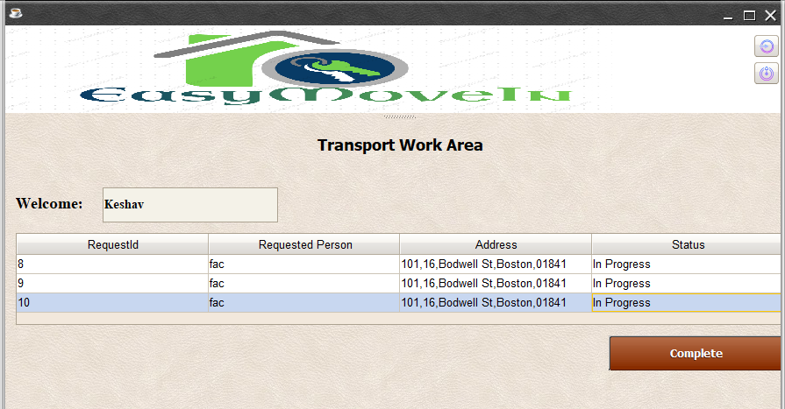
Transport Request

Slide 21
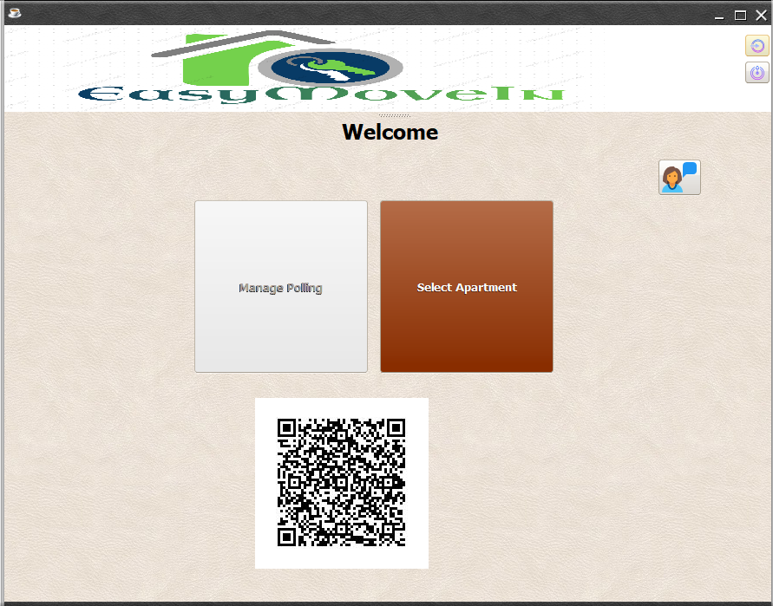
Customer Monitor

Slide 22
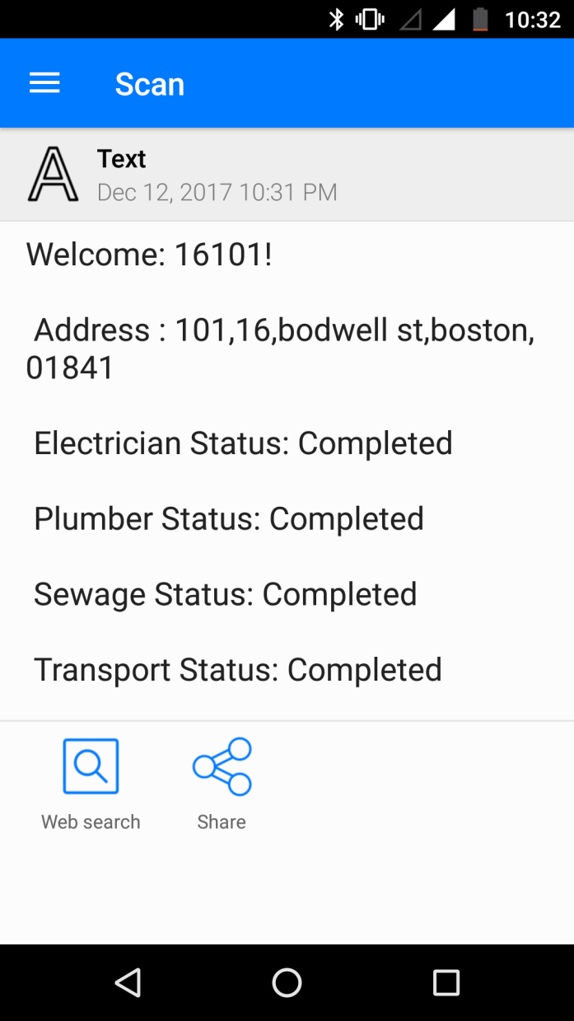
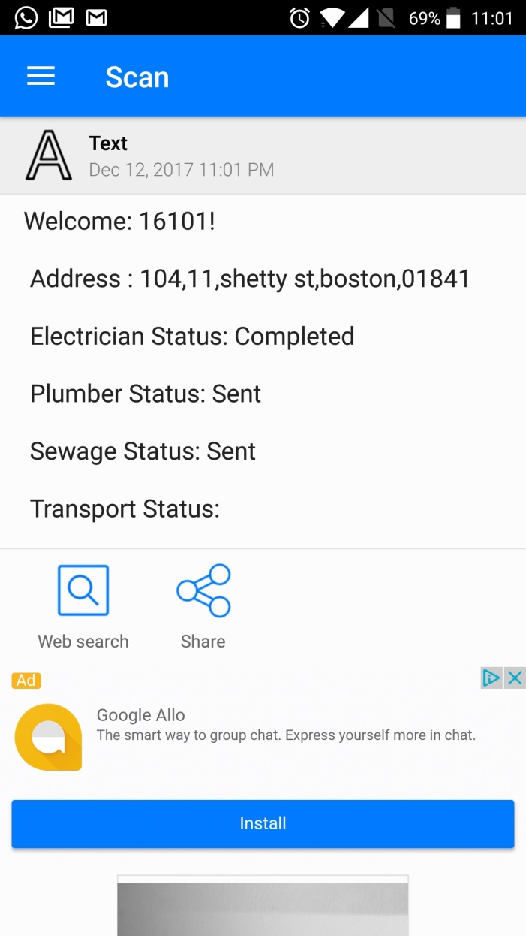
Customer Monitor

Slide 23
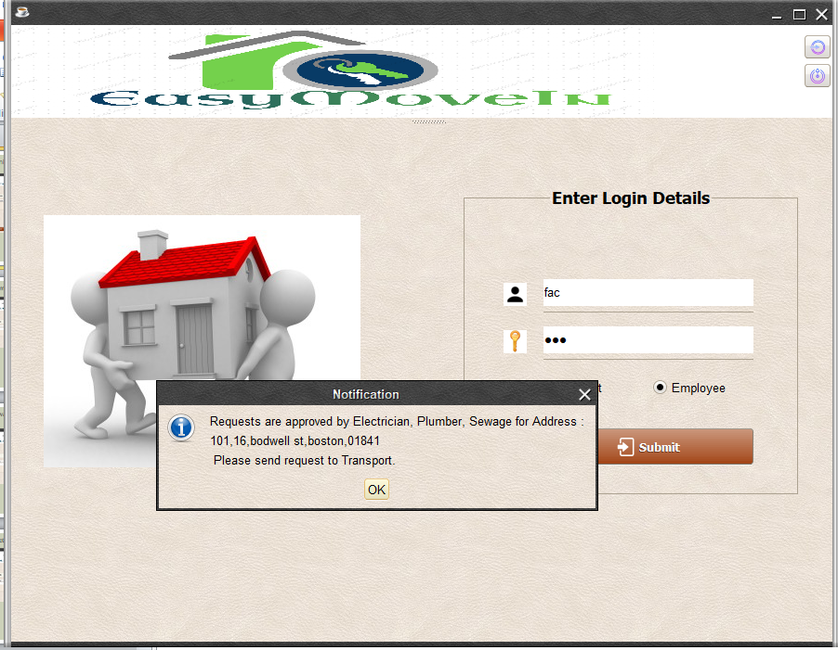
Notification

Slide 24
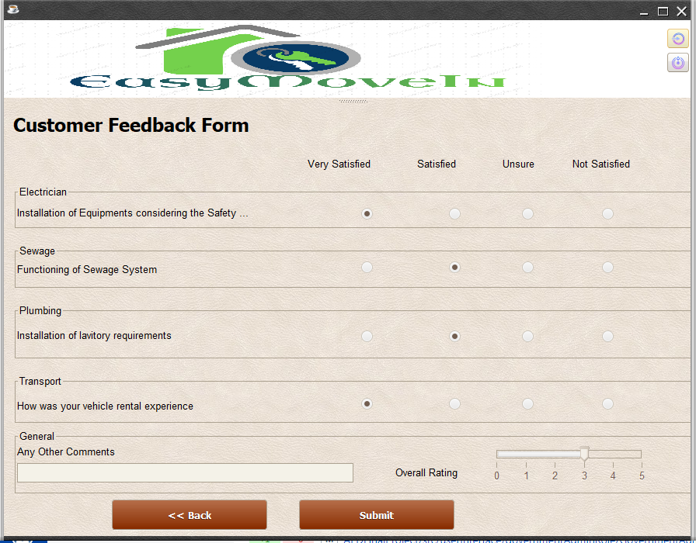
Feedback

Slide 25
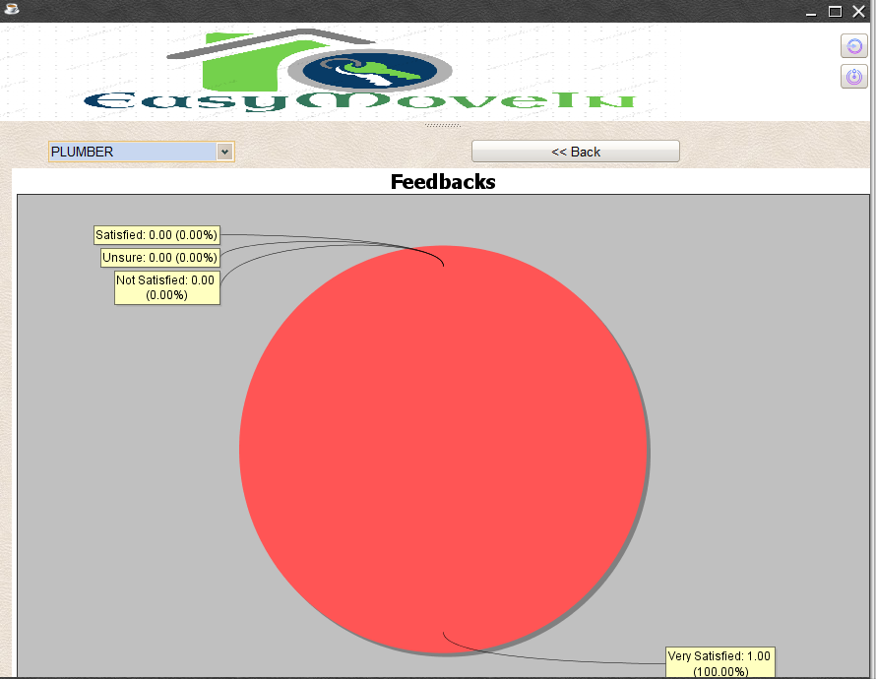
Feedback Graph

Slide 26


